Slide 1



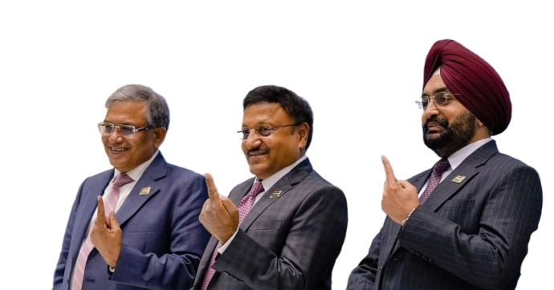
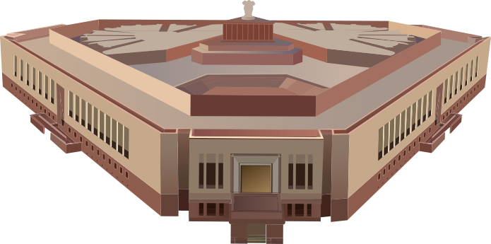
01
E-Voting Website
Heritage Institute of Technology
Members
Sreya Das
Sampriti Chowdhury
Ritesh Ghosh
Suman Bhattacharyya
Biplab Pal

Slide 2
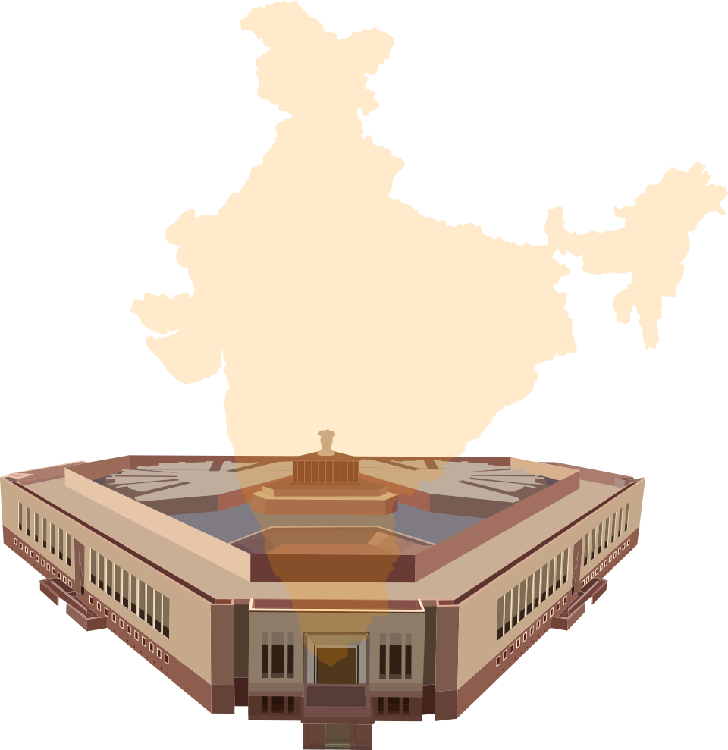
02
Indian e-Vote 2024

Slide 3
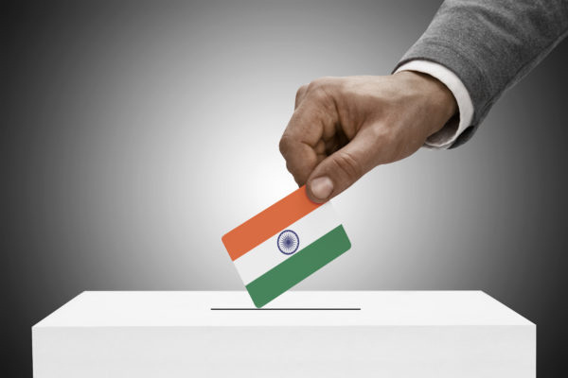
03
Introduction
E-Voting in India modernizes the electoral process, making it more accessible, efficient, and secure. This technology simplifies voting for millions, ensuring each vote is counted transparently and reliably. Aligned with the Digital India vision, e-voting fosters a robust and inclusive democracy.

Slide 4



04
Scope of E-Voting
Increased Voter Participation
Efficiency and Speed
Cost-Effectiveness
Environmental Impact
Transparency and Trust

Slide 5








05
Structure of e-Voting system
Update/Delete
Leader
View overall data
Registration
Login
Admin
Select Vote
Login
View Option
Registration
User

Slide 6
06
System Requirements
HARDWARE REQUIREMENT:
• | PROCESSOR | Dual core and above
• | RAM / ROM | 20 Gb of free disk space & minimum 2Gb of RAM
• | MOTHERBOARD | INTEL
SOFTWARE REQUIREMENT:
•OPERATING SYSTEM | Windows 7 & above
•PROG.LANGUAGE | HTML, CSS, JS,PHP
•DATABASE | MYSQL
•IDE USED | XAMPP, VS CODE,

Slide 7

07
PROJECT’S UI

Slide 8
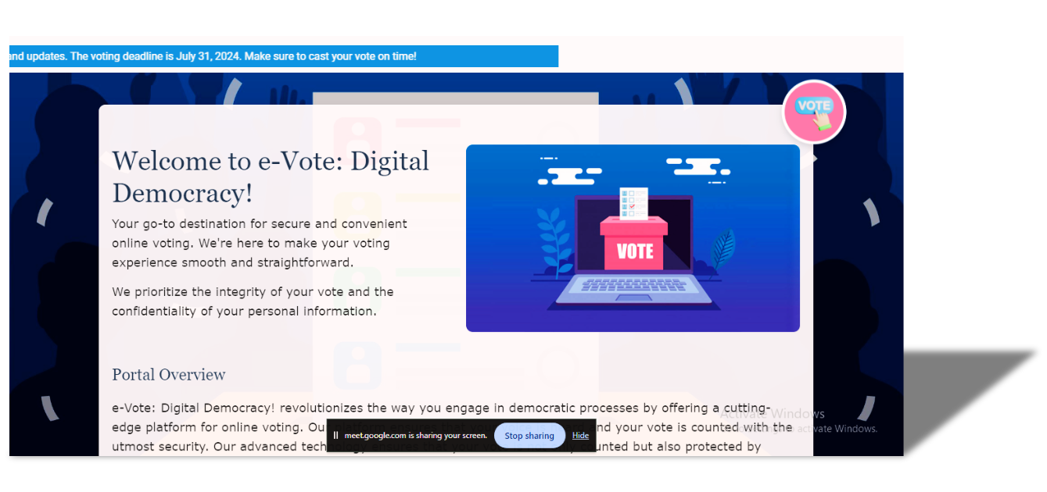
08
Home Page

Slide 9

09
Admin Login Page

Slide 10
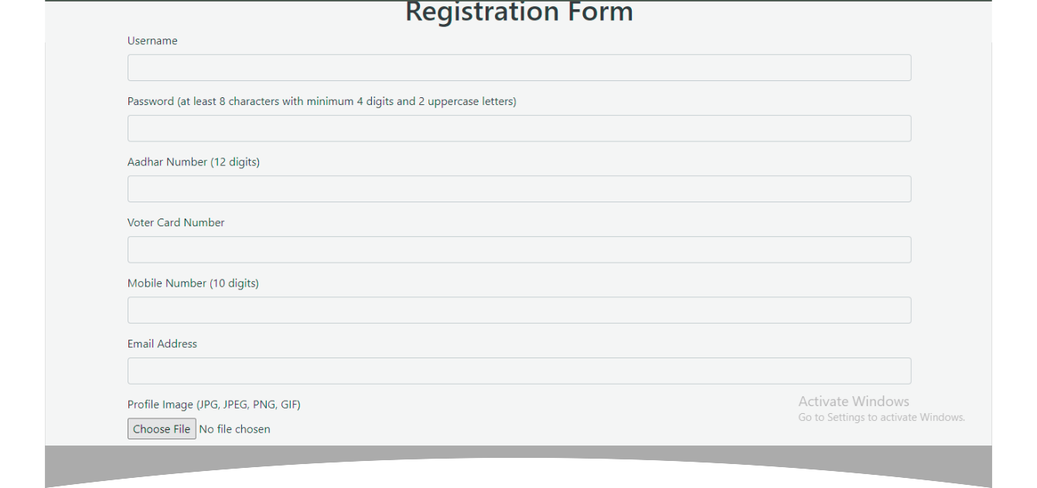
10
User Registration Page

Slide 11
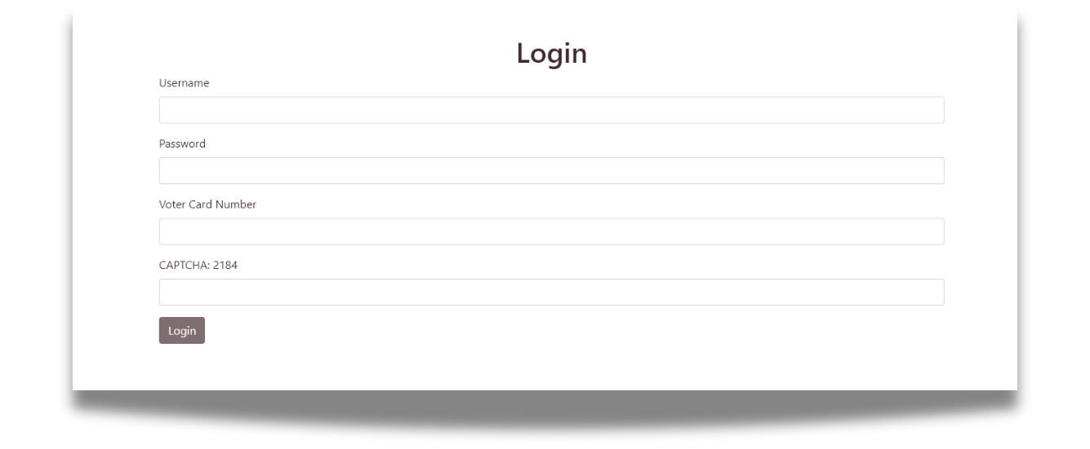
11
User Login Page

Slide 12
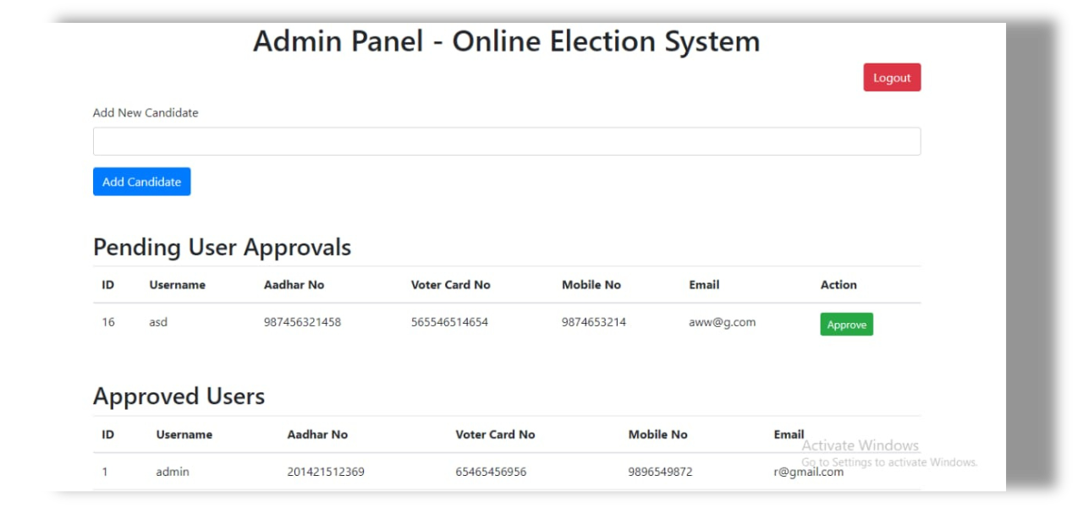
12
Admin Dashboard

Slide 13
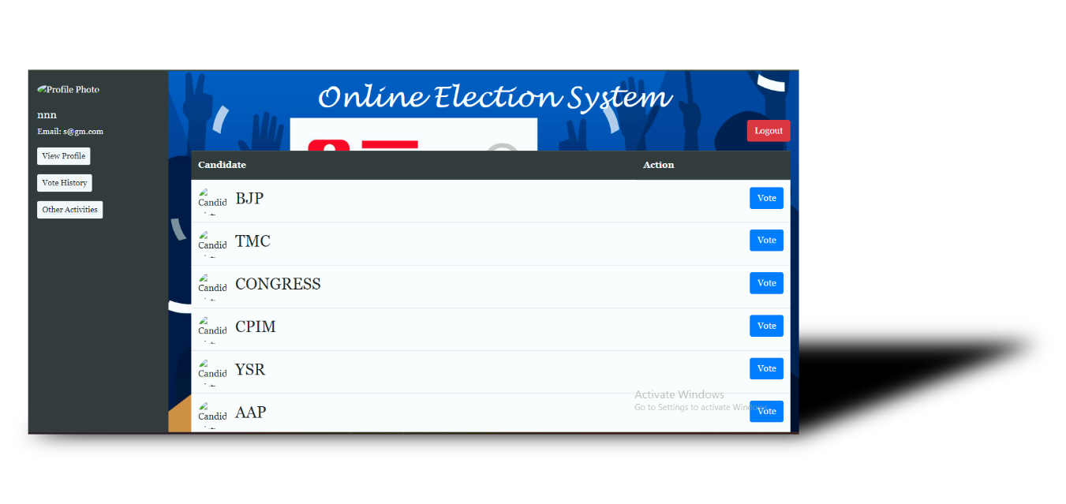
13
User Dashboard

Slide 14
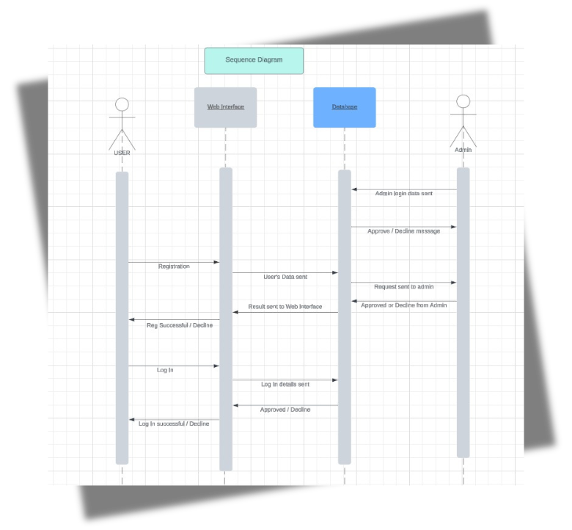
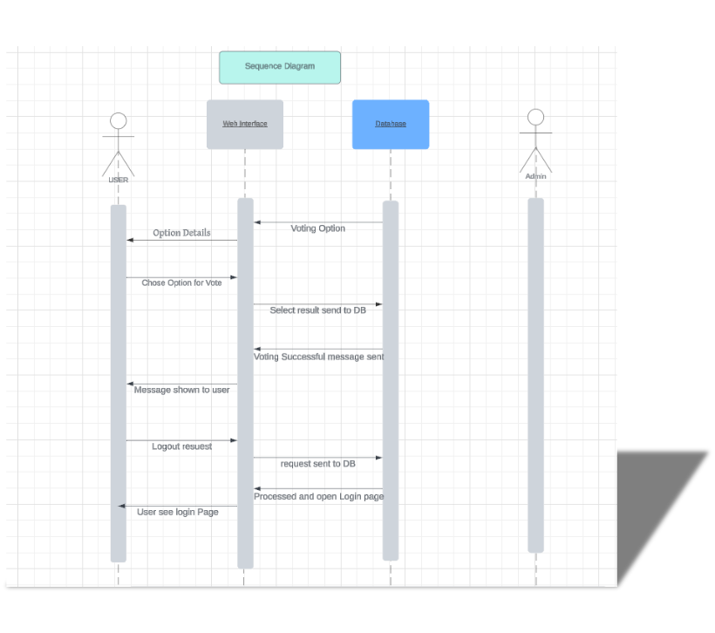
14
SEQUENCE DIAGRAM

Slide 15

Future Scope
15
Blockchain Integration
Global Voting
Use AI and Ml to check voter Behavior
Public Awareness and Education
Mobile Voting
Scalability and Performance
Biometric Authentication
Hybrid Voting Models
Real-Time Data Analytics
Use IoT to build smart Voting Station

Slide 16
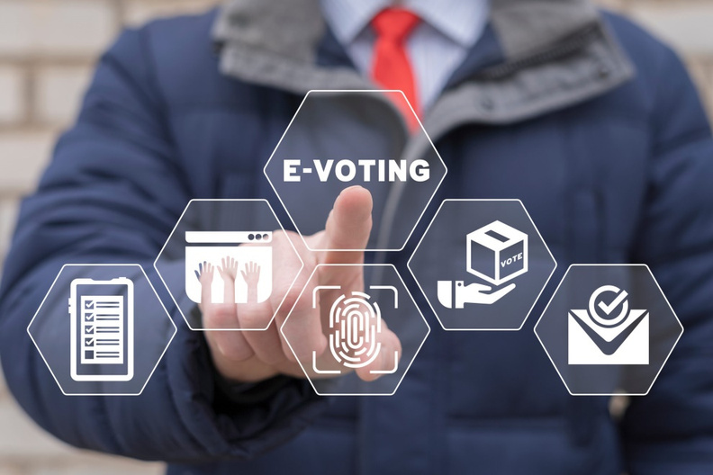

16
Conclusion
E-voting represents a transformative step towards modernizing elections in India, offering enhanced accessibility, efficiency, and security. By leveraging advanced technologies, e-voting ensures a transparent and reliable voting process, aligned with the Digital India vision. As we look to the future, continued innovation and adoption of emerging technologies will further strengthen and democratize our electoral system, fostering a robust and inclusive democracy.
Notes:
15

Slide 17





Thank You!
We respect your valuable time with Us
If you have any questions, please reach us
Do you have any request, please visit our e-Voting site.
CREDIT: Subhojit Santra(Sir)
https://en.wikipedia.org/wiki/Electronicvoting

